Slide 1
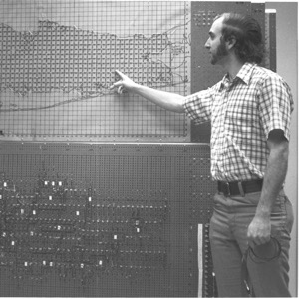
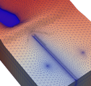
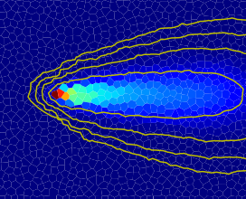



Introduction to MODFLOW 6
Advanced MODFLOW Training Class, November 22, 2024, Deltares, NL

Slide 2
MODFLOW 6 Objectives
Provide a single program that consolidates simulation capabilities in the numerous MODFLOW variants, including, for example:
MODFLOW-2005
MODFLOW-LGR
MODFLOW-NWT
MODFLOW-USG
SEAWAT
GSFLOW
Support multiple model instances and multiple model types in a single simulation
Provide a platform for extending MODFLOW into a configurable hydrologic simulator

Slide 3
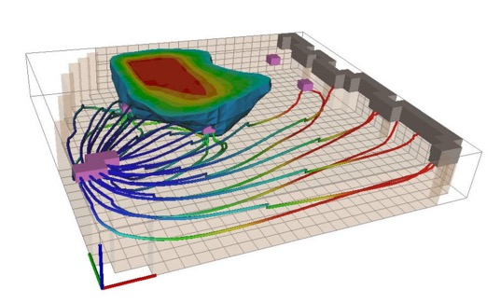
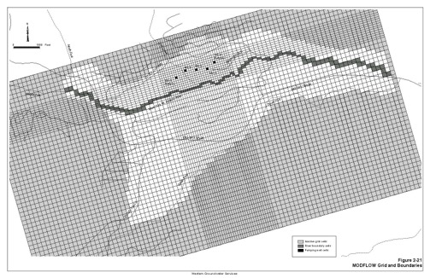
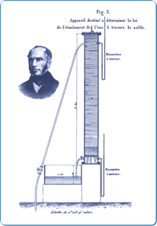
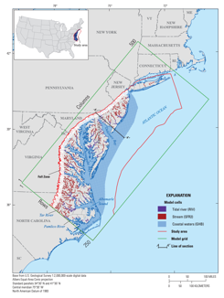
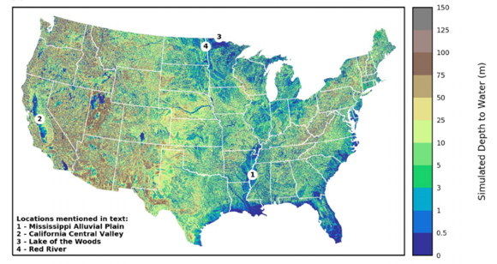
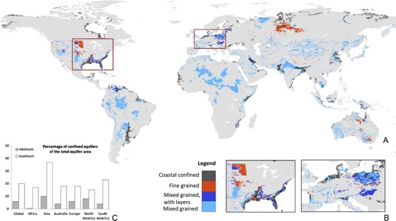
Range of Scales for MODFLOW Applications
bench
site
subregional
regional
national
global

Slide 4
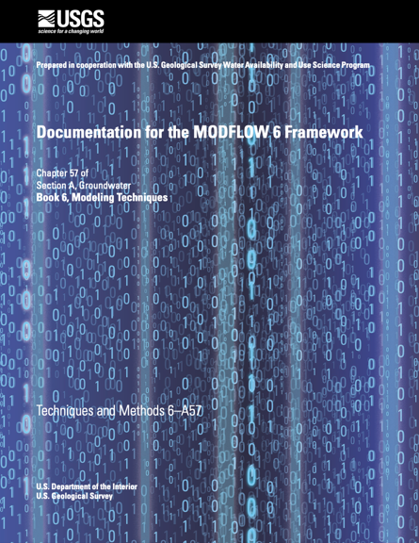
MODFLOW 6 Components
Models
Exchanges
Solutions
Timing
Simulation

Slide 5
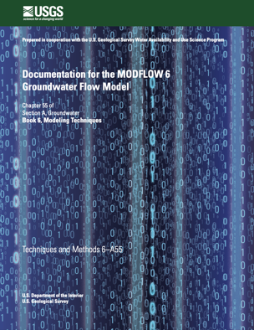
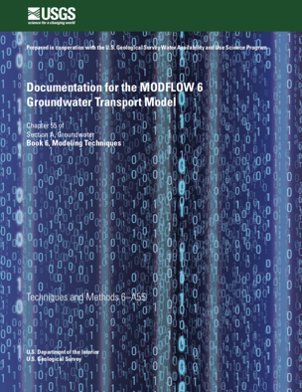
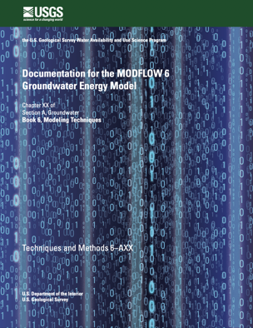
Model Types
Particle Tracking (PRT)
Surface Water Flow (SWF)
Groundwater Flow (GWF)
Groundwater Transport (GWT)
Groundwater Energy Transport (GWE)
Watershed
Linear Network Flow (LNF)
Published
Coming soon
In development

Slide 6
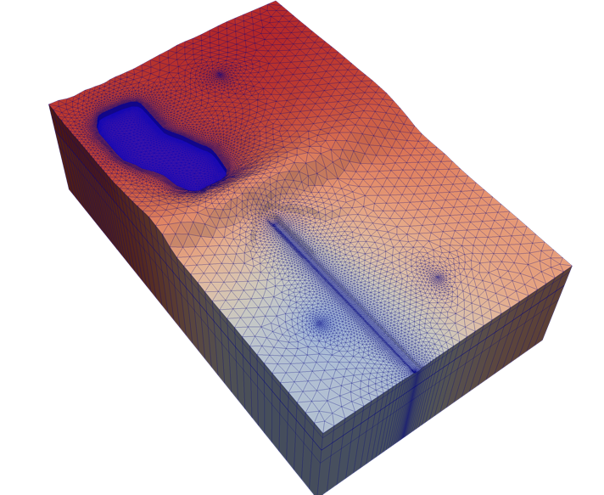
Groundwater Flow (GWF) Model
Highlights
Structured or unstructured grids
Newton or standard formulation
Full 3D anisotropy (XT3D)
Compaction and subsidence (CSUB)
Multiple stress packages of the same type
Advanced stress packages (SFR, LAK, MAW, UZF)
Water mover (MVR)

Slide 7
Groundwater Flow (GWF) Model
Discretization (DIS, DISV, DISU)
Node Property Flow (NPF)
Storage (STO)
Specified Head (CHD)
General-Head Boundary (GHB)
Stream-Flow Routing (SFR)
Initial Conditions (IC)
Horizontal Flow Barrier (HFB)
Compaction and Subsidence (CSUB)
Well (WEL)
Drain (DRN)
Lake (LAK)
Output Control (OC)
Ghost Node Correction (GNC)
Recharge (RCH)
River (RIV)
Multi-Aquifer Well (MAW)
Observations (OBS)
Buoyancy (BUY)
Evapo-transpiration (EVT)
Unsaturated Zone Flow (UZF)
Water Mover
(MVR)
Viscosity (VSC)
Data Input
Internal Flow
Internal Flow
Hydrologic Stress Package
Advanced Stress Package
Notes:
This is the structure of the GWF Model in MODFLOW 6
If you haven't used MODFLOW 6 before, it's very similar to previous MODFLOW versions; however,
We added a few things; we took a few things out.
We continuously ensure that MF6 gives the same answers as mf2005, mfnwt, mfusg (and if not, then why not)
MODFLOW 6 was developed as an object-oriented program:
To you, this means you can have more than one instance of certain things, like packages and models
Packages are objects, so we can have more than one package of the same type (when it makes sense). Not a big deal, but possibly useful
Simulation can have more than one GWF Model
LPF -> NPF, STO, ...

Slide 8
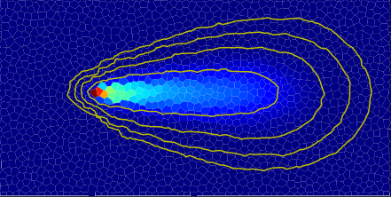
Groundwater Transport (GWT) Model
Highlights
Structured or unstructured grids
Advection, dispersion, sorption, decay/growth
Mobile and immobile domains
Advanced packages (SFT, LKT, MWT, UZT)
Water mover for transport (MVT)

Slide 9
Groundwater Transport (GWT) Model
Mobile Domain
Immobile Domain
Discretization (DIS, DISV, DISU)
Advection (ADV)
Mobile Storage and Transfer (MST)
Source and Sink Mixing (SSM)
Streamflow Transport (SFT)
Immobile Storage and Transfer (IST)
Initial Conditions (IC)
Dispersion (DSP)
Mass Source Loading (SRC)
Lake Transport (LKT)
Output Control (OC)
Constant Concentration (CNC)
Multi-Aquifer Well Transport (MWT)
Observations (OBS)
Unsaturated Zone Transport (UZT)
Flow Model Interface (FMI)
Mover Transport
(MVT)
Data Input
Internal Transport
Internal Transport
Solute Stress Package
Advanced Solute Stress Package
Internal Transport

Slide 10
Exchanges
Communication between any two models occurs through an ”exchange”
Exchange types include:
GWF-GWF: connects two GWF Models
GWT-GWT: connects two GWT Models
GWF-GWT: provides the simulated flows from a GWF Model to a GWT Model
MODEL
EXCHANGE
MODEL

Slide 11
Solutions
Dependent variables for one or more models are calculated by a “solution”
A focus of MODFLOW 6 has been on the Iterative Model Solution (IMS)
IMS solves for head (GWF) or concentration (GWT)
SOLUTION
MODEL
EXCHANGE
MODEL

Slide 12
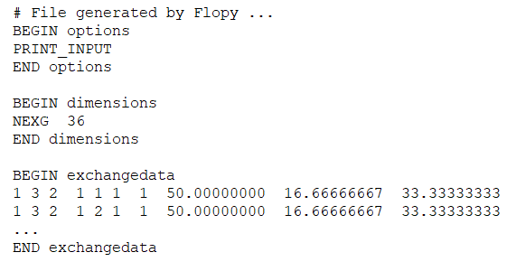
Exchange Data
Model 1
Model 2
Connect two GWF models by specifying a GWF-GWF Exchange in the configuration
Exchange file contains geometrical data for connection between neighboring nodes
L_{m}
Δw
m
L_{n}
n
Notes:
A user can couple two GWF models by specifying a GWF-GWF exchange. The exchange file contains geometrical data for how cells are connected across models.

Slide 13
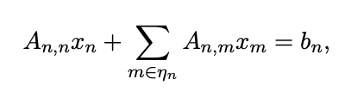
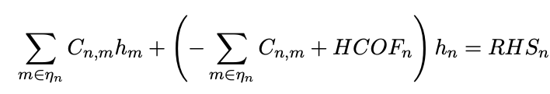
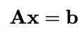
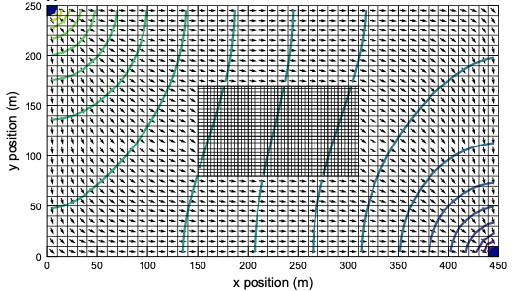
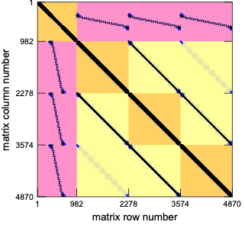
Generalized Control-Volume Finite-Difference Numerical Solutions

Slide 14
Single-Model Configurations
Simulation
Simulation
Temporal Discretization
Temporal Discretization
Numerical Solution
Numerical Solution
Groundwater Flow Model
Groundwater Transport Model

Slide 15
Multi-Model Configurations
Simulation
Simulation
Temporal Discretization
Temporal Discretization
Numerical Solution
Numerical Solution 1
Groundwater Flow Model 1
Groundwater Flow Model
Groundwater Flow Model 2
Numerical Solution 2
GWF-GWF Numerical Exchange
Groundwater Transport Model
GWF-GWT Exchange

Slide 16
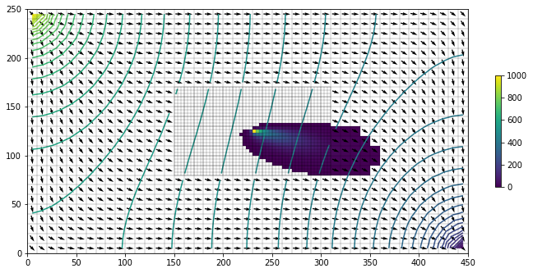
Multi-Model Configurations
Simulation
Temporal Discretization
Numerical Solution 1
Groundwater Flow Model 1
Groundwater Flow Model 2
GWF-GWF Numerical Exchange
Numerical Solution 2
Groundwater Transport Model 1
Groundwater Transport Model 2
GWT-GWT Numerical Exchange
GWF-GWT
Exchange 1
GWF-GWT
Exchange 2

Slide 17
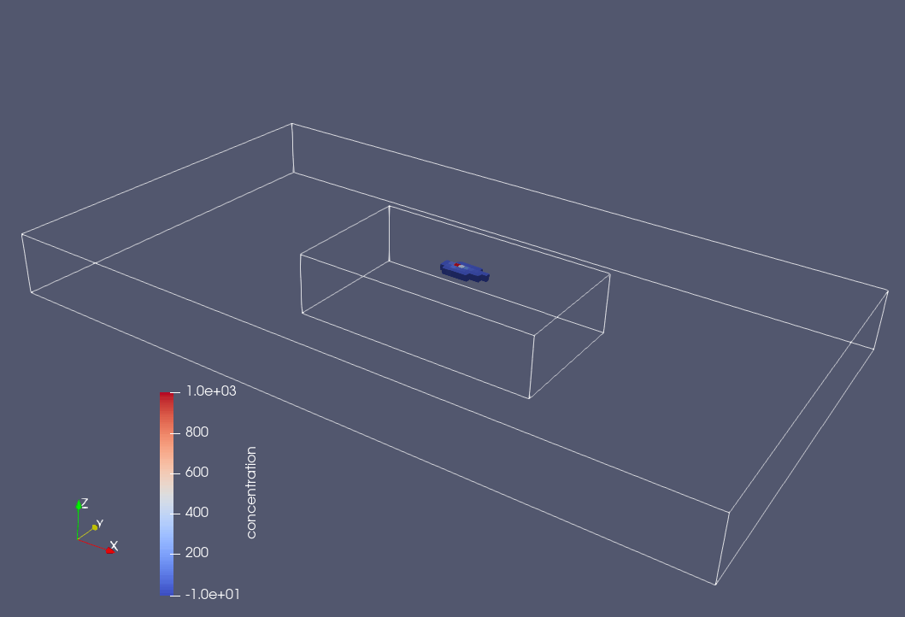

Slide 18
Summary
MODFLOW 6 is based on the concept of models, exchanges, and solutions
For users, the underlying model/exchange/solution architecture provides flexibility for configuring complex multi-model simulations
The new parallel capabilities build on these concepts to allow simulation of multiple models in parallel

Slide 19
MODFLOW 6 Timeline
2013 – Initiated development
2017 – First release with the Groundwater Flow (GWF) Model
2020 – MODFLOW Application Programming Interface (API)
2020 – Release of Groundwater Transport (GWT) Model
2023 – Release of parallel simulation capabilities
2024 – …

